Slide 1
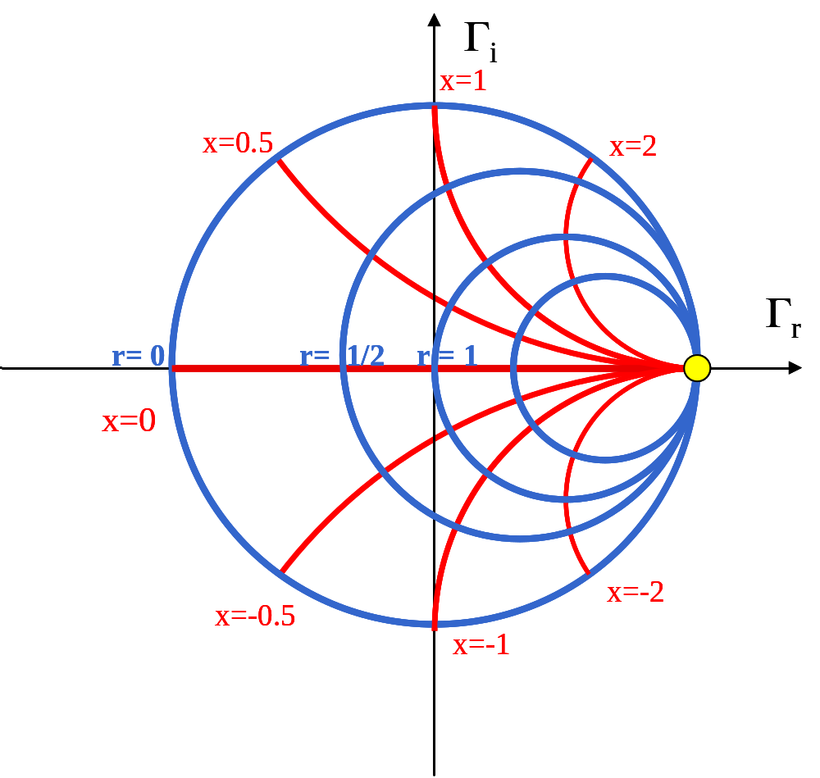
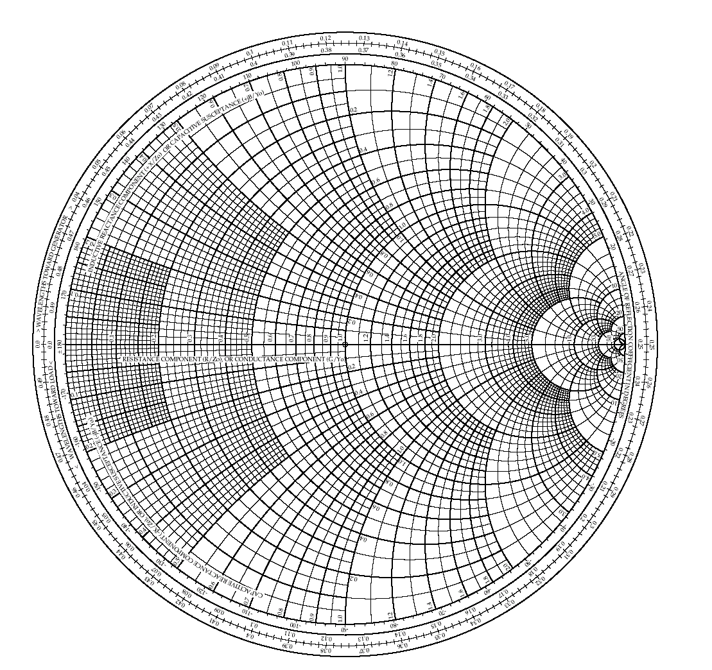
§2.3 The Smith Chart

Slide 2
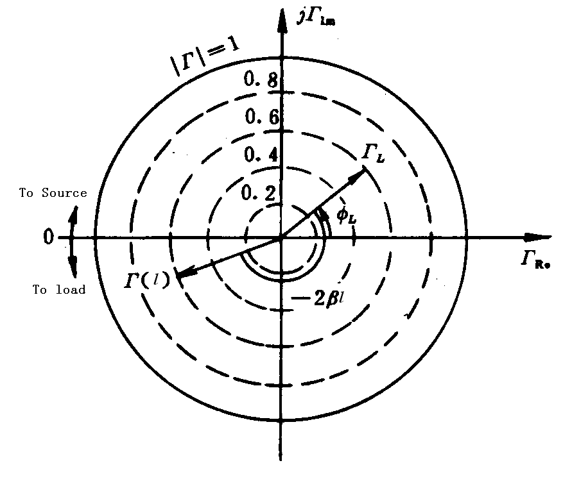
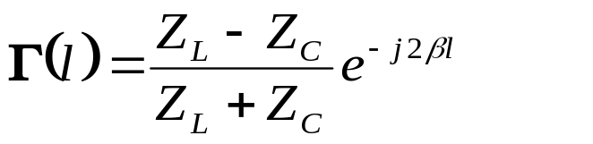
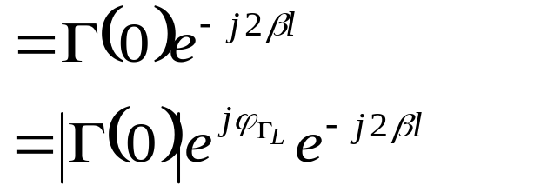
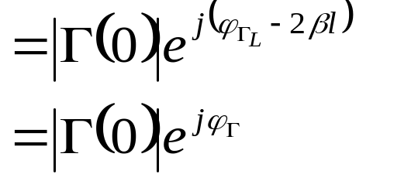
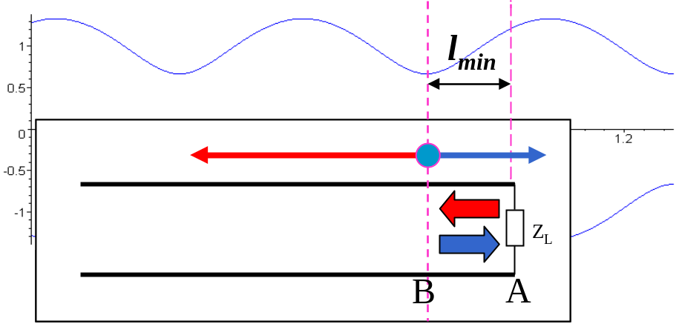
§2.3 The Smith Chart
1、Reflection coefficient circles

Slide 3
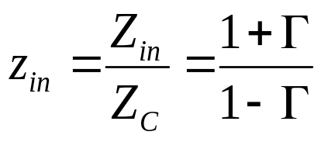
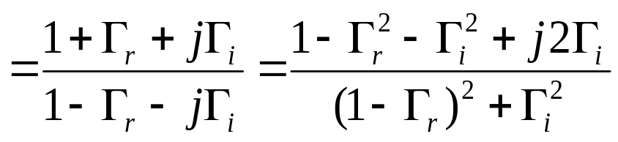


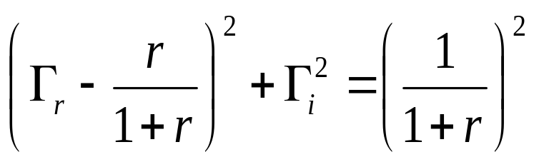
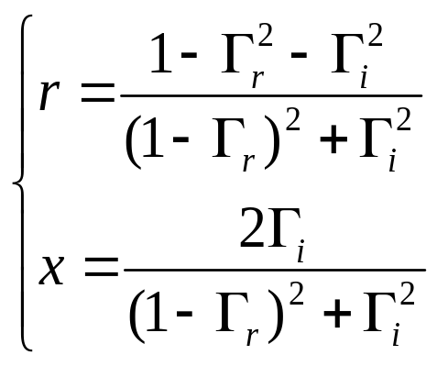
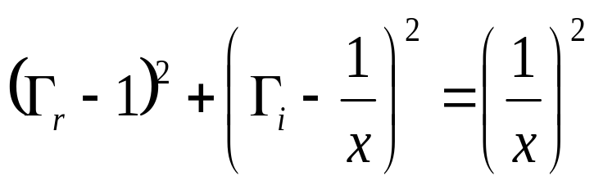
2. Equi-resistance circles and reactance circles
§2.3 Smith Chart
then

Slide 4
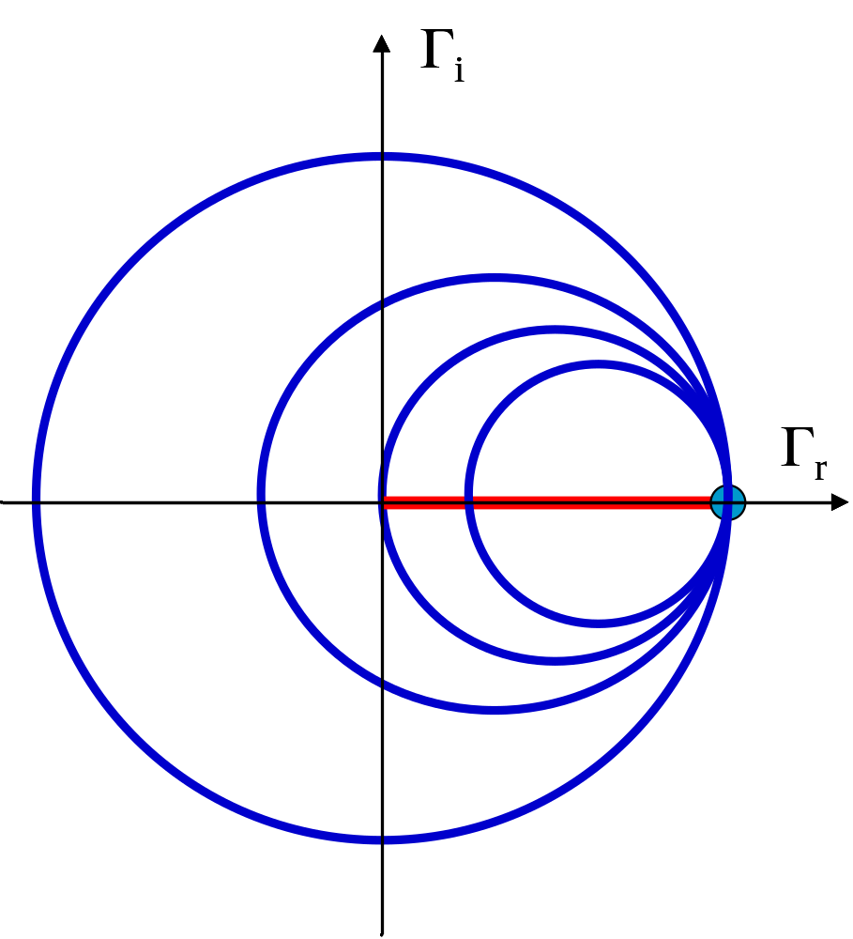
§2.3 Smith Chart——2. Resistance circles and reactance circles
r=1/2
r=0
r=1
r=2
r=∞
r | 0 | 1/2 | 1 | 2 | ∞
center | (0,0) | (1/3,0) | (1/2,0) | (2/3,0) | (1,0)
radius | 1 | 2/3 | 1/2 | 1/3 | 0

Slide 5
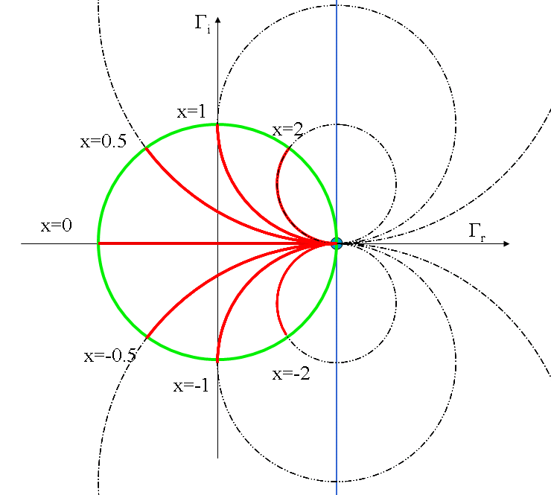
§2.3 Smith Chart——2. Resistance circles and reactance circles
x | 0 | ± 0.5 | ± 1 | ± 2 | ∞
center | (1, ±∞) | (1, ±2) | (1, ±1) | (1, ±1/2) | (1,0)
radius | ±∞ | 2 | 1 | 1/2 | 0
x=∞

Slide 6
The Smith Chart

Slide 7
The Smith Chart

Slide 8
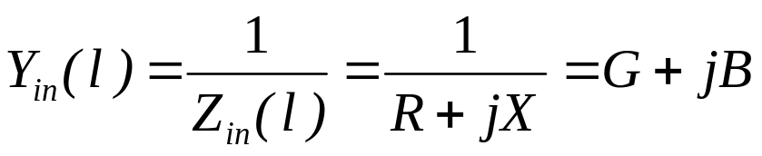
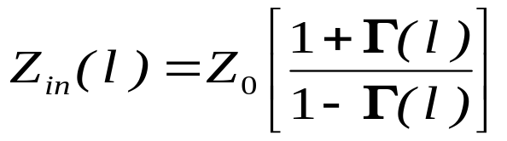
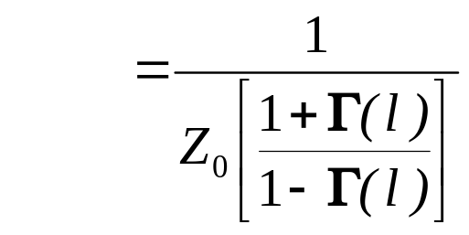
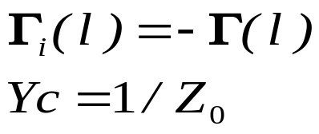
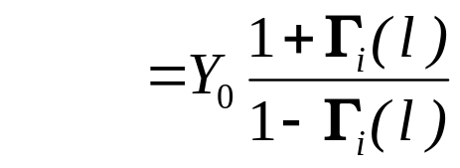
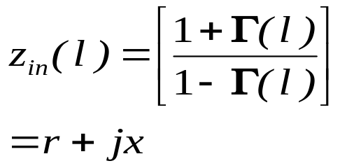
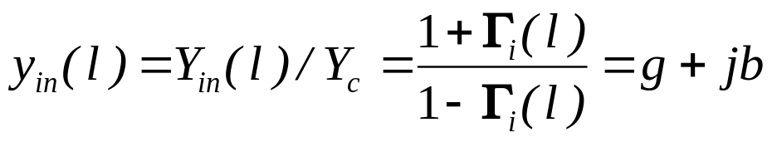
3. The Combined Impedance-Admittance Smith Chart
§2.3 Smith Chart
Admittance:
Compared with
Normalized admittance:
Admittance smith chart：
Resistance r | — | Conductance g
Reactance x | — | Susceptance b
Γ_{u} | — | Γ_{I}

Slide 9
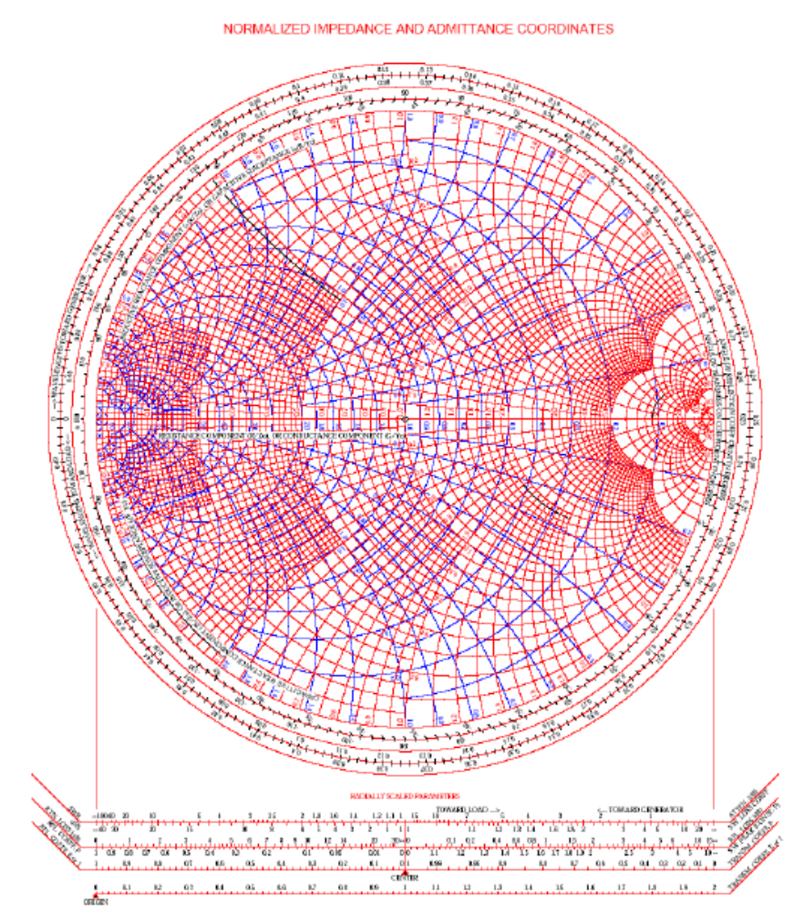
The combined impedance-Admittance Smith Chart

Slide 10
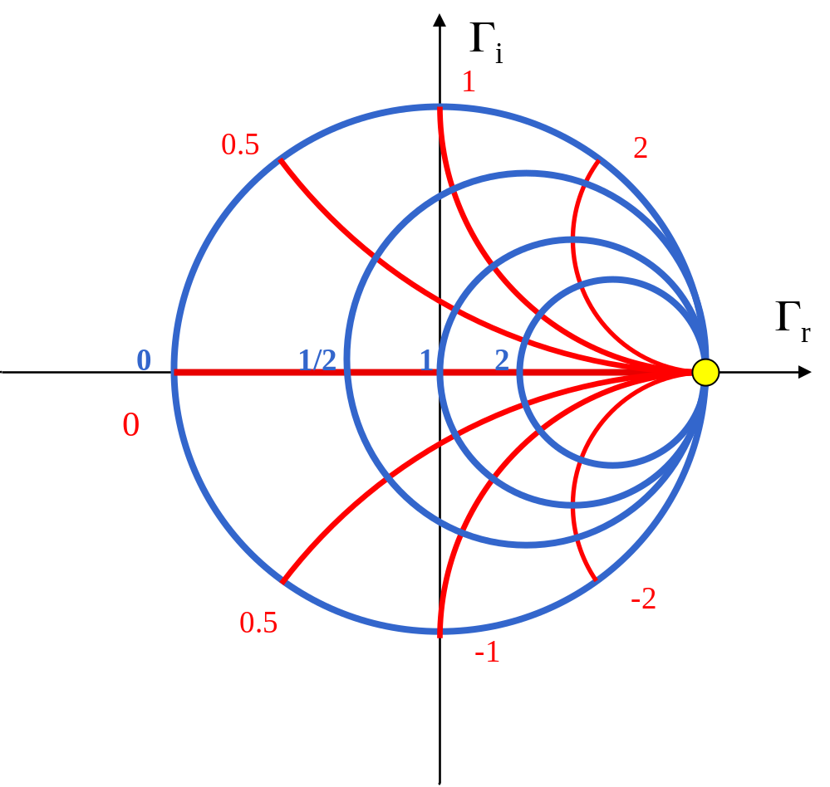
§2.3 Smith Chart——3. The Combined Impedance-Admittance Smith Chart
z
A
0.2/0.3
-
B
0.25
z
z

Slide 11
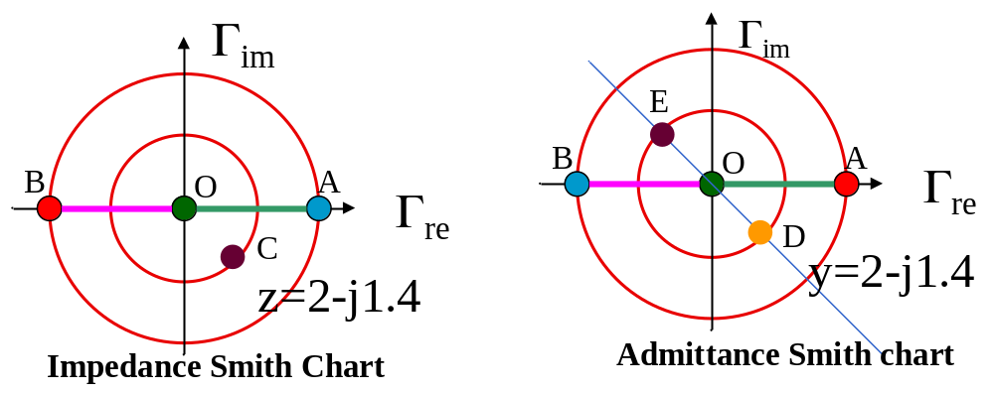
§2.3 Smith Chart——3. The Combined Impedance-Admittance Smith Chart
 | Impedance smith chart |  | Admittance smith chart
O (0,0) | Matched point | — | Matched point
A (1,0) | Open circuit point (z＝∞) | — | Short circuit point (y= ∞)
B (-1,0) | Short circuit point (z=0) | — | Open circuit point (y=0)
OA | Voltage wave anti-node (r=ρ) | — | Current wave anti node (g=ρ)
OB | Voltage wave node (r=1/ρ) | — | Current wave node (g=1/ ρ)
Upper semicircle | x>0，inductive | — | b>0，capacitive
Lower semicircle | x<0，capacitive | — | b<0，inductive
Unit circle | r=0，pure reactance | — | g＝0，pure susceptance

Slide 12
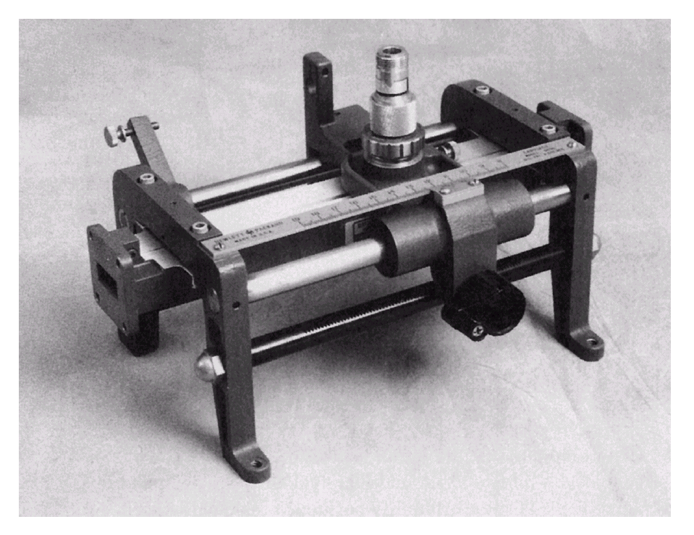
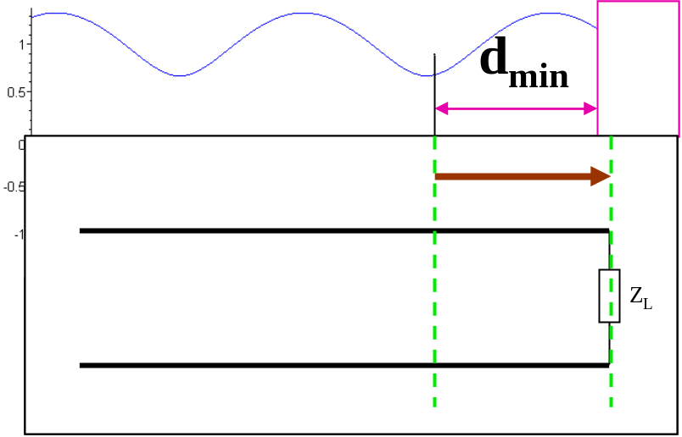
§2.3 Smith Chart——4. applications of Smith chart
the slotted line
A slotted line is a transmission line configuration that allows the sampling of the electric field amplitude of a standing wave on a terminated line. With this device the SWR and the distance of the first voltage minimum from the load can be measured, and from this data the load impedance can be determined.
An X-band waveguide slotted line.

Slide 13
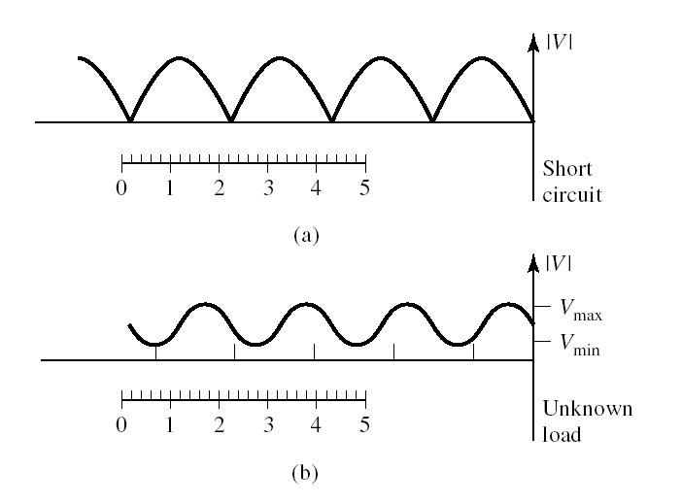

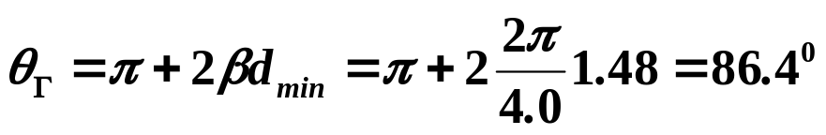
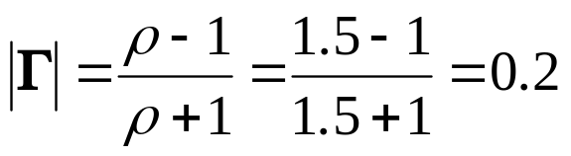
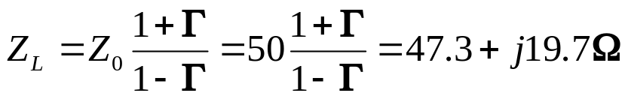
On the arbitrarily positioned scale on the slotted line, voltage minima are recorded
z1=0.2, 2.2, 4.2cm
z2=0.72, 2.72, 4.72cm
SWR=V_{max}/V_{min}=1.5
(a) Standing wave for short-circuit load.
(b) Standing wave for unknown load.

Slide 14
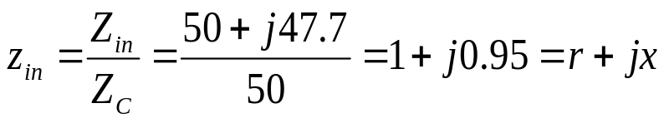

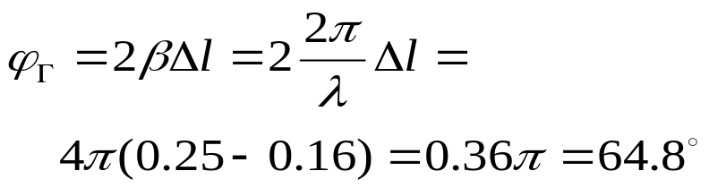
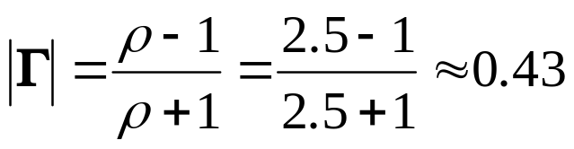
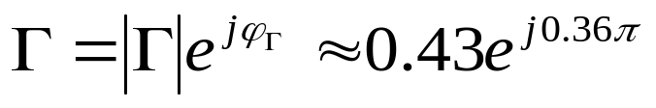
§2.3 Smith Chart —— 5. examples
Example 1：a Z₀=50Ω transmission line，Z_{in}＝（50＋j47.7）Ω，find Γ at the input of the line
Solution：
1）Normalized
B
0.16
r=1 and x＝0.95 → point A
2）ϕ_{Γ}
Radial line OA, → point B,
Electric length 0.16
A
0
O
C
0.25
3）|Γ|
  At the wave anti-node (on the positive real axis), z_{in}=VSWR=ρ，
  point C，r＝2.5 → ρ＝2.5, then
2.5

Slide 15
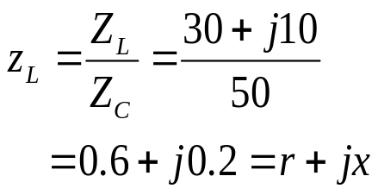
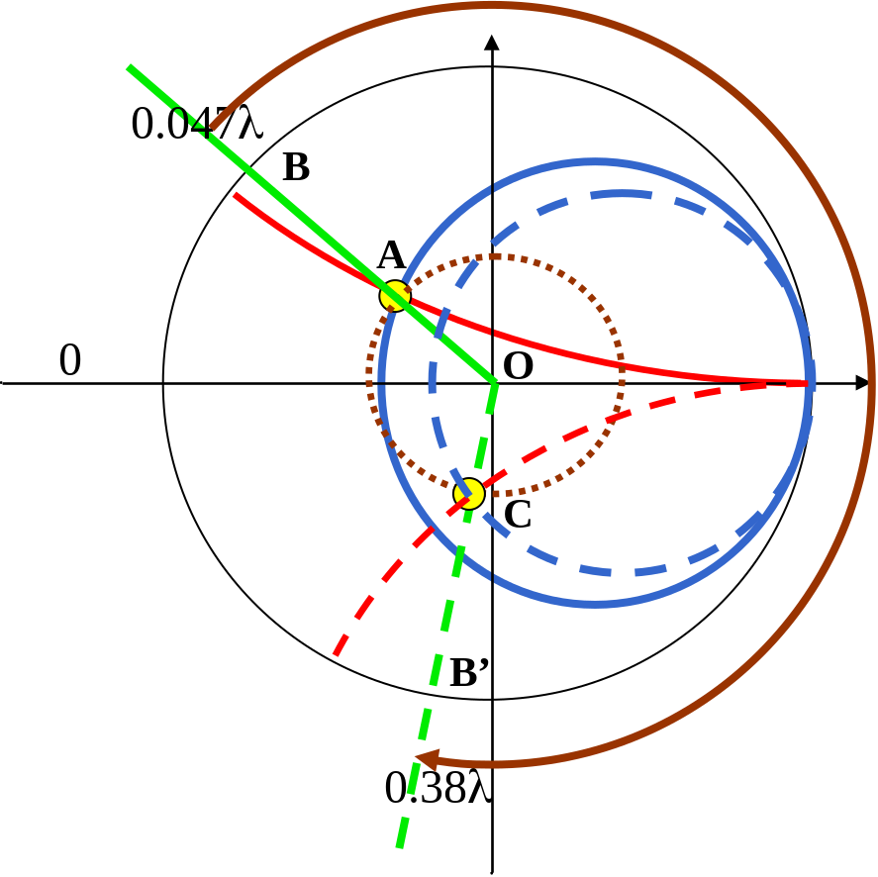
λ/3
§2.3 Smith Chart —— 6. examples
Example 2：Z₀=50Ω，Z_{L}=(30+j10)Ω
Find input impedance Z_{in}(l=λ/3)
Z_{L}
Solution：
1）normalize
2) Calculate z_{in}
  point A
  → OA → point B → 0.047λ
  rotate clockwise: λ/3
  0.047λ＋λ/3≈0.38 λ → point B’
  point C: r=0.83, x=-0.5
z_{in}=0.83-j0.5
3）Z_{in}=z_{in}Z_{c}=(0.83-j0.5)×50＝ (41.5-j25)Ω

Slide 16
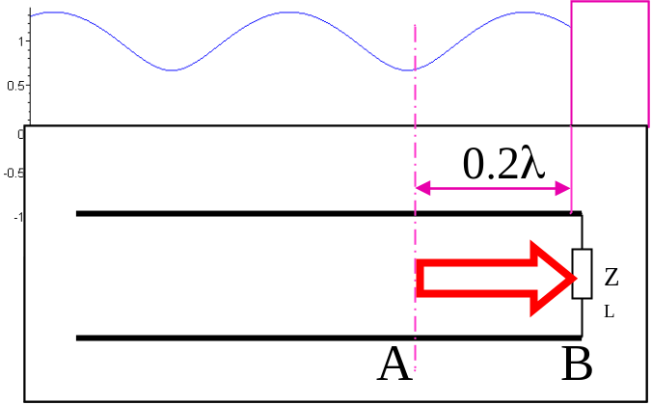
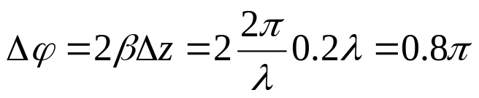
§2.3 Smith Chart —— 6. examples
Example 3：a Z₀=50Ω Transmission line,ρ＝2.5，point A is the voltage wave node which is 0.2 λ to the load，find Z_{L}
Solution：
（1）point A is voltage wave node
z＝1/ρ=1/2.5=0.4
point A is on the negative real axis, r=0.4
（2）pointA →0.2λ → point B
rotate anti-clockwise
OA: z/λ=0，then OB: z/λ=0.2
0
A
O
1.67
(3) Load impedance (point B)
z_{L}＝1.67-j1.04
Z_{L}＝z_{L}×Z_{c}＝(1.67-j1.04)×50
=(83.5-j52Ω)
0.4
B
0.2
-1.04

Slide 17
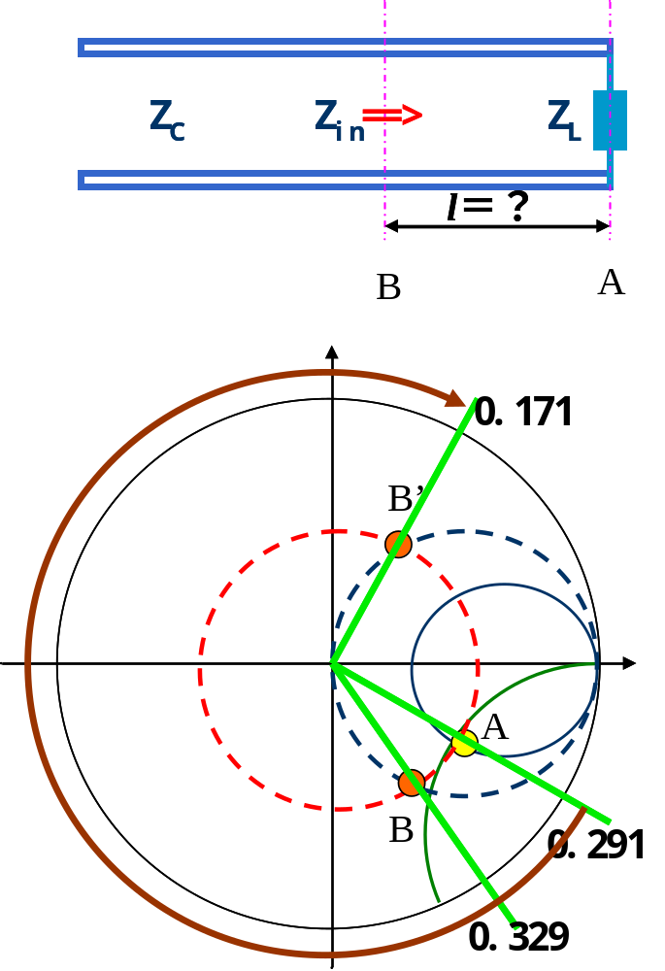

§2.3 Smith Chart —— 6. examples
Example 4 ：Z₀=50Ω，Z_{L}=(100－j75)Ω, Z_{in}=50＋jx
Find the length of the transmission line
（1） normalize Z_{L} and Zin
z_{L}=Z_{L}/Z_{C}=(100-j75)/50=2-j1.5
z_{in}=Zin/Z_{c}=(50+jX)/50=1+j0.02X
（2）z_{L} →point A → |Γ| circle
point B is on the |Γ| circle
（3）point B: z_{B}=1＋j0.02x
point B is on the circle: r＝1
（4） two circles → B & B’ → l

